Slide 1

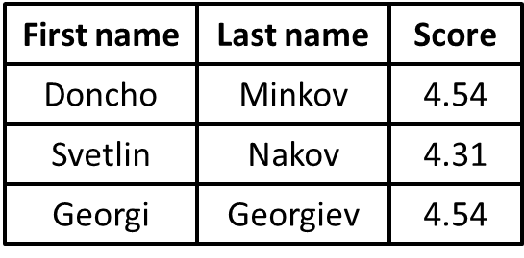
Welcome to Our Web Site
Nav item 1
Nav item 1
Nav item 1
Nav item 1

